Slide 1
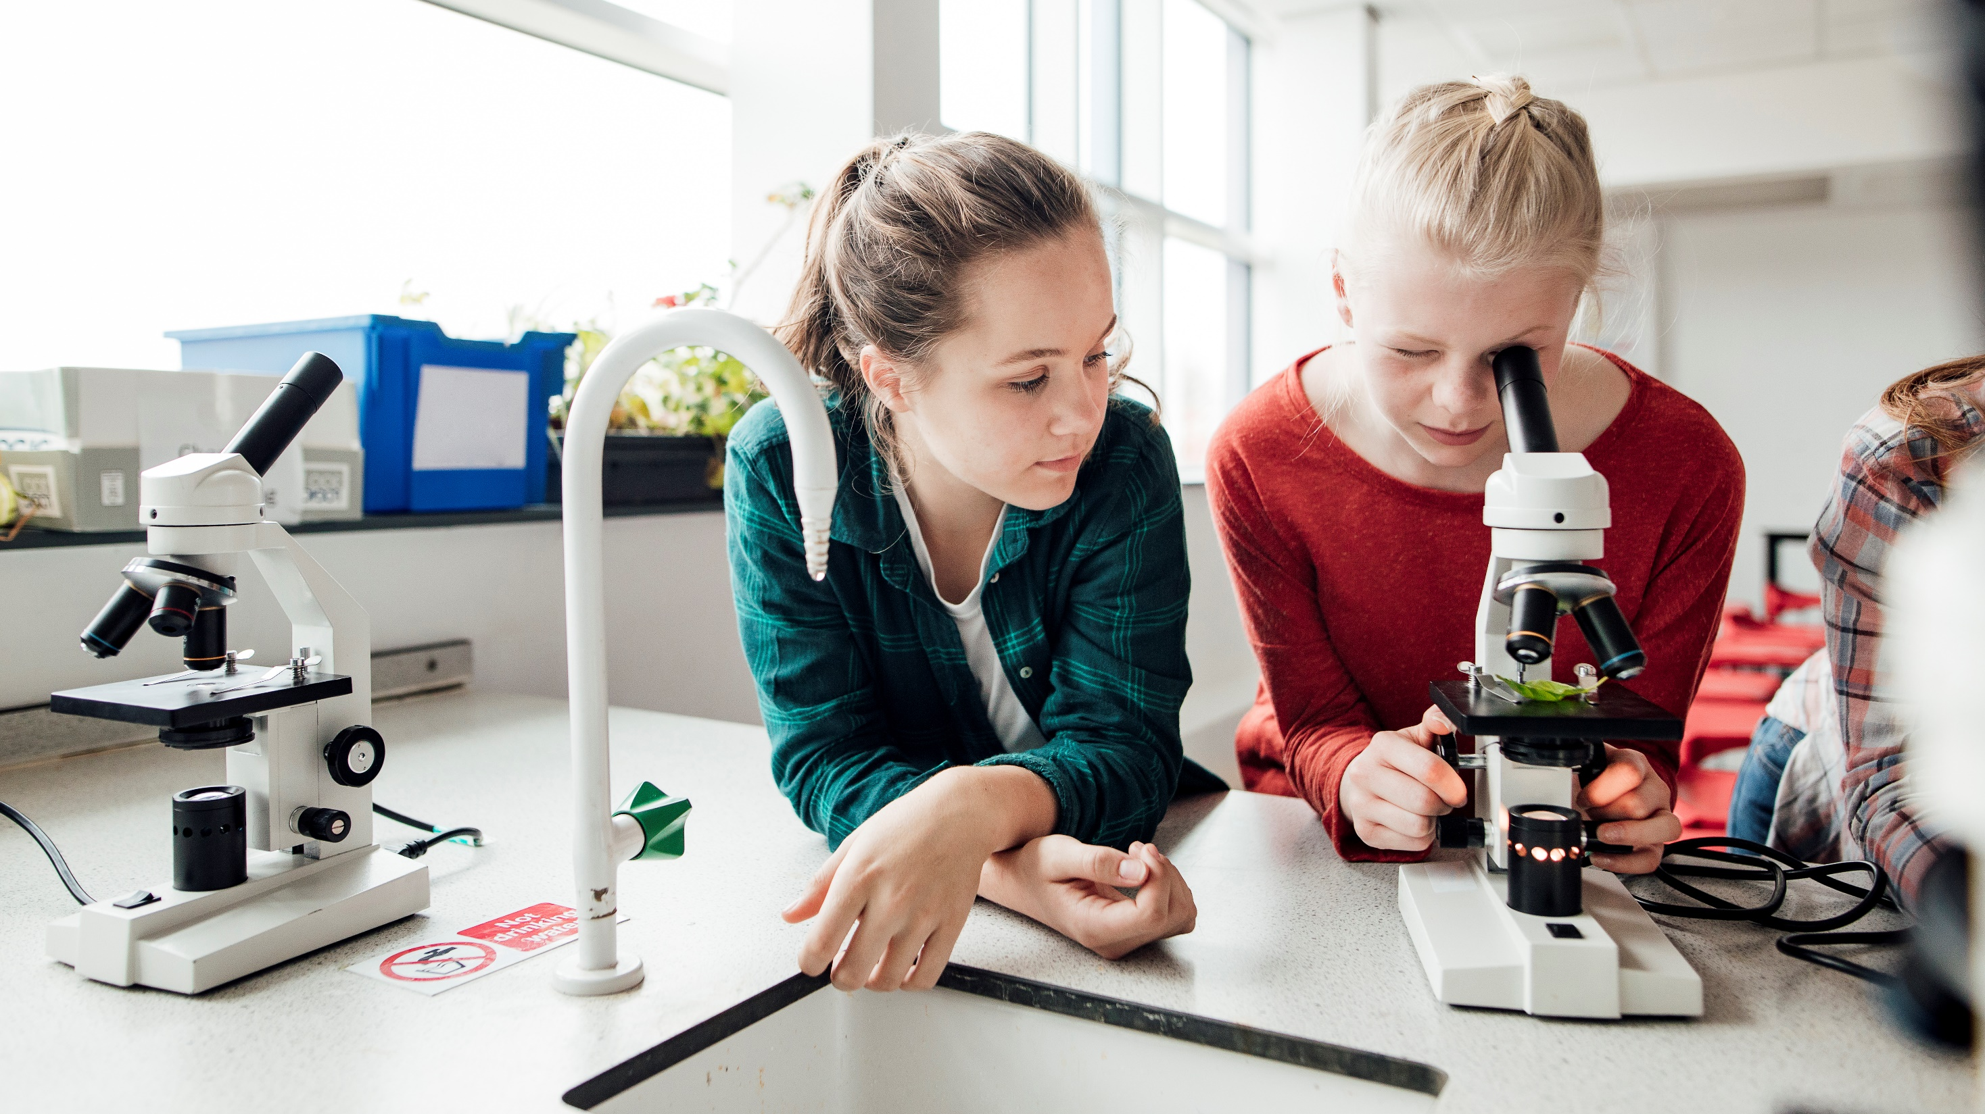
The Cambridge Program (AICE) Gainesville High School

Slide 2
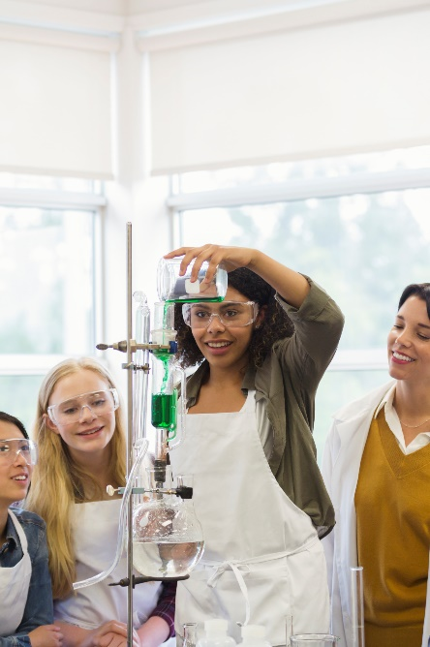
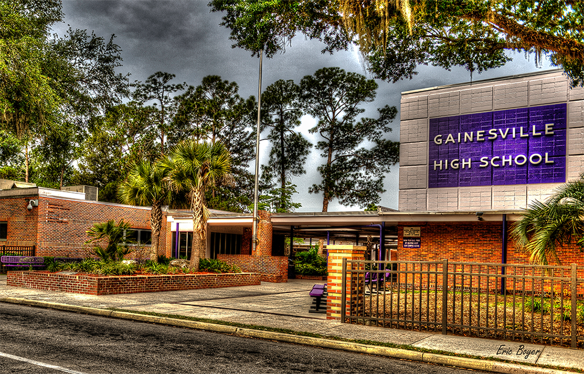
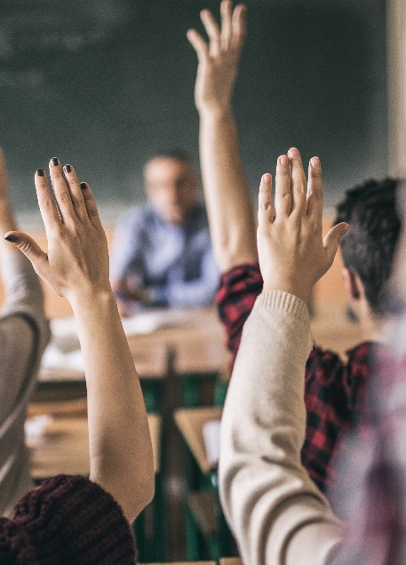
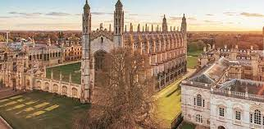
What is Cambridge?
Cambridge is an advanced, rigorous curriculum.
Cambridge students have an opportunity to obtain an AICE (Advanced International Certificate of Education) diploma.
Cambridge students have an opportunity to earn college credit.

Slide 3
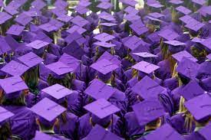
What are the benefits of the program?
AICE courses and their exams are equal to about 45 hours of college credit (1 ½ years).
The AICE diploma automatically guarantees the highest level of the Bright Futures Scholarship: around $30, 000!
Improved collaborative, analytic, and researching skills
New perspectives of the world on various issues and circumstances

Slide 4
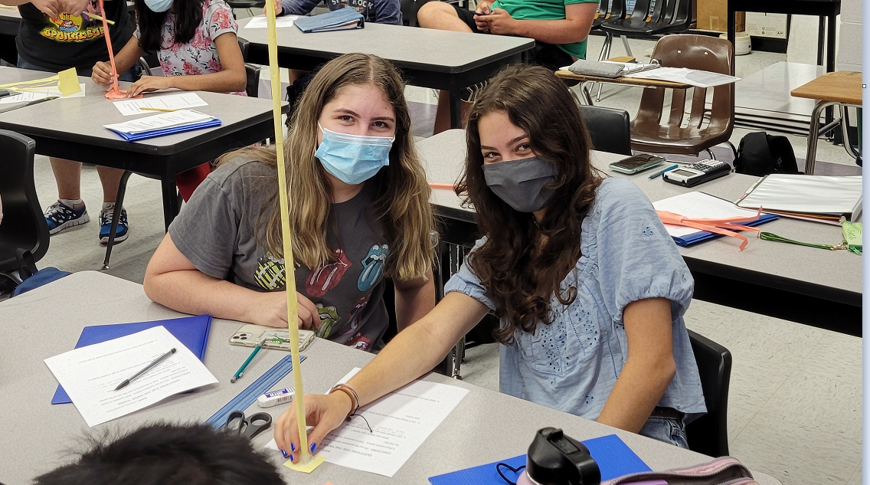
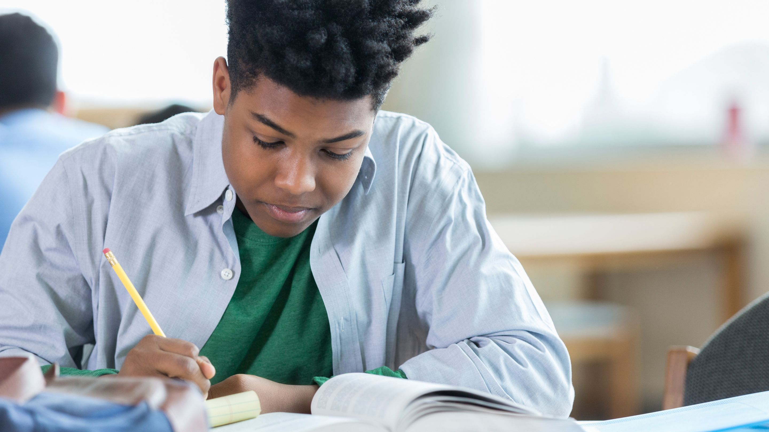
the Curriculum
^{9th} Grade: • Geometry Honors OR Geometry Honors/Math Team
• Pre-AICE Biology
• AP World History
• Pre-AICE English Language I
^{10th} Grade: • Algebra II Honors or Algebra II Honors
Math Team
• Pre-AICE Chemistry
• AP European History
• Pre-AICE English Literature II
^{11th} Grade: AICE Valencentics Math Team or AICE
Valencentics
• AICE United States History
• AICE English Language
• AICE/AP Biology (double block) or
• AICE/AP Chemistry (double block) or
• AICE/AP Physics or
• AICE Environmental Management or
• AICE Marine Science
^{12th} Grade: • AP Calculus AB (Calculus 1) or Calculus
BC (Calculus 1 and 2)
• AICE Global Perspectives
• AICE English Literature
• AICE Thinking Skills
• AICE/AP Biology (Double block) or
• AICE/AP Chemistry (Double block) or
• AICE Physics or
• AICE Environmental Management or
• AICE Marine Science

Slide 5
You must complete seven credits total Group 1: Math and Sciences Group 2: Languages Group 3: Arts and Humanities Group 4: Interdisciplinary Subjects (optional) You must achieve at least one credit from Groups 1, 2, and 3 in order to qualify. These credits are earned through taking and passing AICE exams.

Slide 6
CORE CLASS: Cambridge international AS level Global Perspectives and Research (GPR)
This is a skills-based course in which you’ll broaden your horizons regarding our rapidly changing world. It will prepare your research, analysis and argumentative skills. It will enhance your collaboration skills through group projects as well as build your confidence and presentation skills.

Slide 7
How can I get in touch with my counselor?
Ms. Noguerol
Email: noguerolcm@gm.sbac.edu
Go to the GHS website under “Student Services”
Select “Student Services”
Select “School Counseling”
Click link for “Appointments”

Slide 8
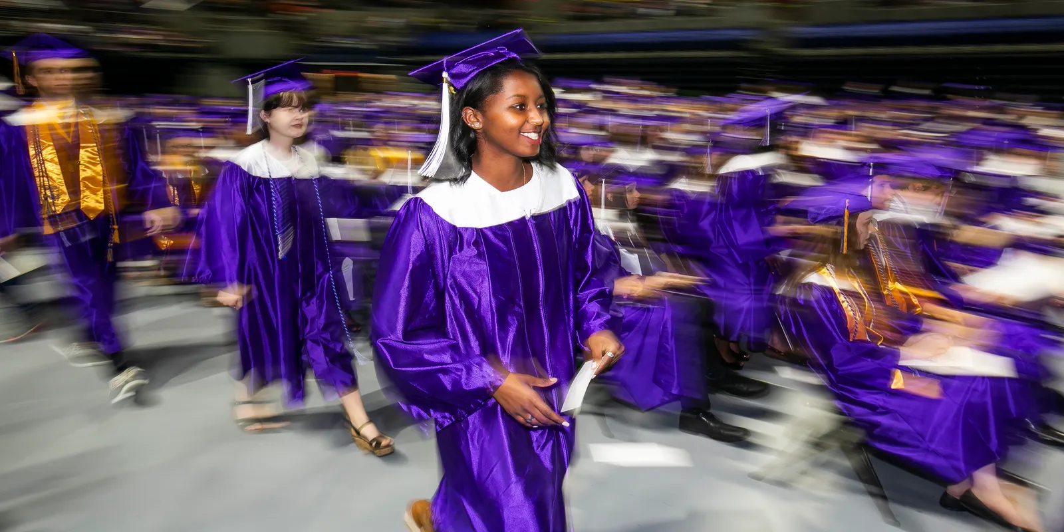
Welcome to GHS!
it’s a great day to
be a hurricane!

